Slide 1

Data Training in Deep Learning
Siu Sai Cheong

Slide 2
About Me
SIU Sai Cheong (scsiu@hsu.edu.hk)
Programme Director, Bachelor of Translation with Business Programme
Programme Director, Master of Arts in Translation (Computer-aided Translation) Programme
Former Director, Deep Learning Research and Application Centre

Slide 3
My Research Areas
Translation Technology
Artificial Intelligence for Professional Language Services and Creative Industries

Slide 4
Outline
1. Deep Learning: A Brief Introduction
2. Model Training: Key Steps
3. Other Interesting Issues

Slide 5
Deep Learning and Artificial Intelligence

Slide 6
AI
Machine Learning
Symbolic AI
Deep Learning
Other methods

Slide 7


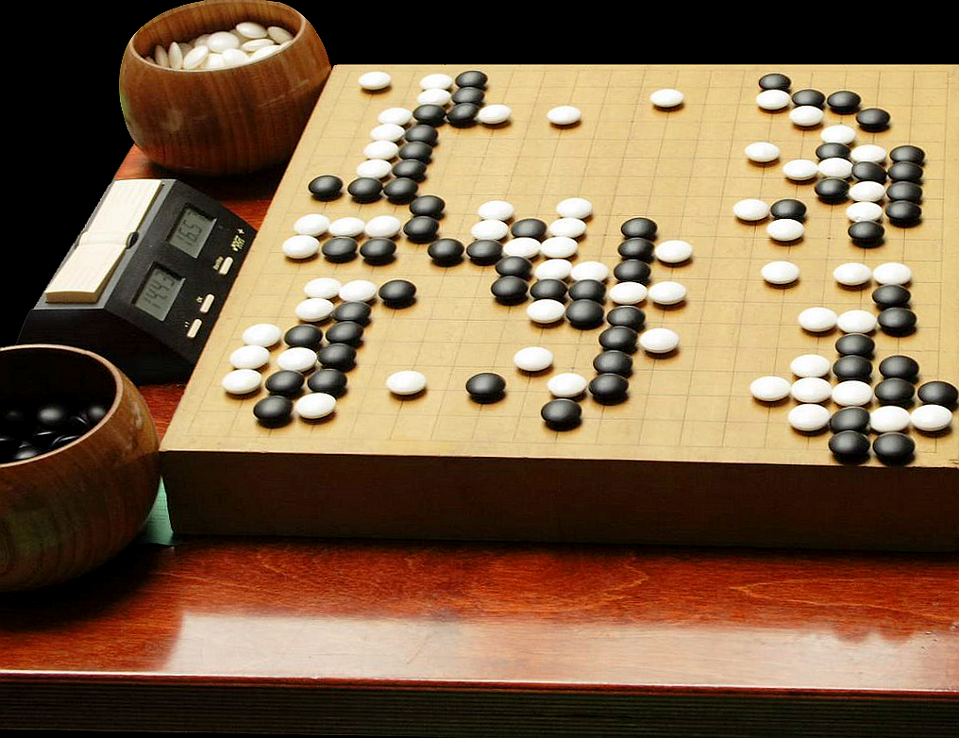
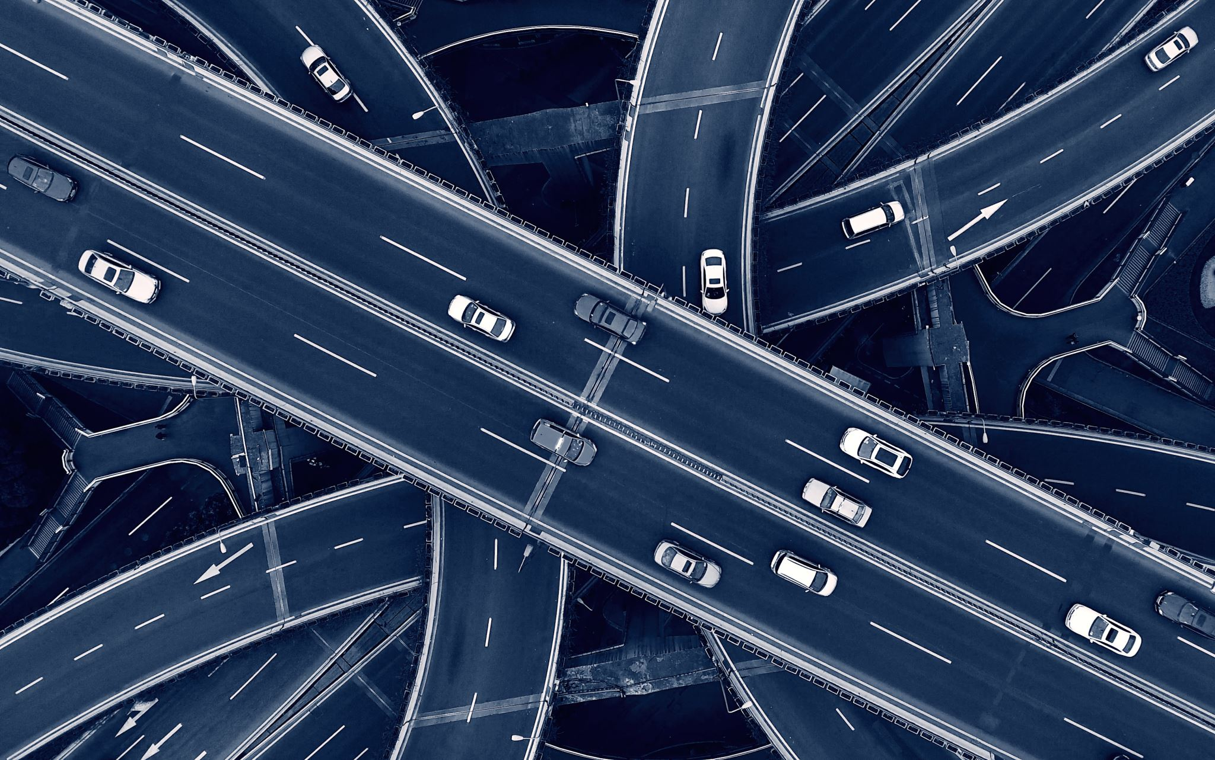

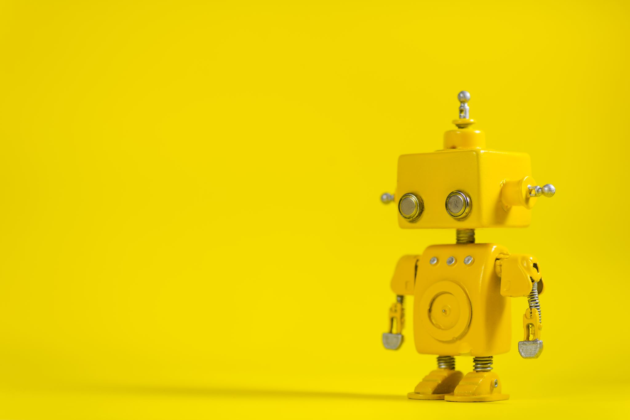
Object Detection
Times Series Forecasting
AlphaGo
Automated Driving
Image Classification
Robotics

Slide 8
My Deep Learning Projects
Text and Speech Translation
Image Translation
Other Natural Language Processing (NLP) Tasks

Slide 9
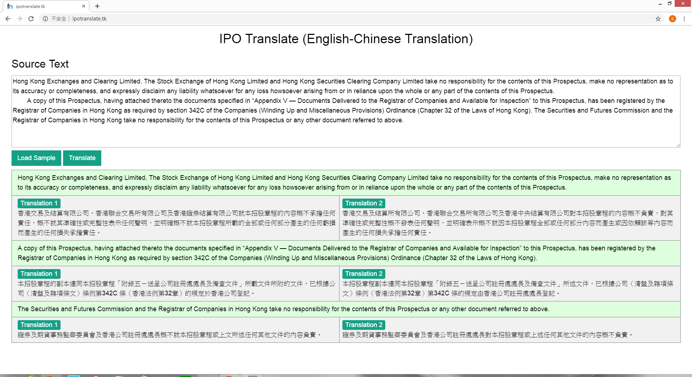

Slide 10


Slide 11
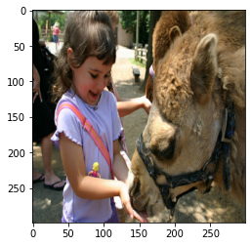
Image-to-text translation
女孩餵駱駝

Slide 12
How does Deep Learning work?

Slide 13
Deep Learning
Artificial Neural Network
Artificial Neuron

Slide 14
Biological Neuron
dendrite
axon terminal
soma
2
activation
“input”
from
other
neurons
axon
“output” to
other
neurons
1
3
nucleus

Slide 15
Artificial Neuron
Input
Weighted average
Example:
1 if sum > 0; otherwise, 0
1
weight = 0.5
Output
0
weight = 0.2
Activation Function
1
Sum
weight = 0.3
(~soma)
(~axon)
Answer： 0.8
1
(~dendrite)

Slide 16
Artificial Neural Network
Input Layer
Hidden Layer
Output Layer

Slide 17
Deep Neural Network
Input Layer
Hidden Layers
Output Layer

Slide 18
Example: Image Classification
Probability
that the picture
is a …
0
1
0
1
0
1
1
0
0.55
0.30
0.10
0.05
cat
tiger
dog
man

Slide 19
Deep Learning: 5 Components
Dataset Creation
Model Design
Model Training
Model Evaluation
Model Inference

Slide 20
Example: Image Classification
1. Dataset Creation
2. Model Design
4. Model Evaluation
Probability
that the picture
is a …
0
1
0
1
0
1
1
0
0.55
0.30
0.10
0.05
cat
tiger
dog
man
3. Model Training
5. Model Inference

Slide 21
How can we train a model?

Slide 22





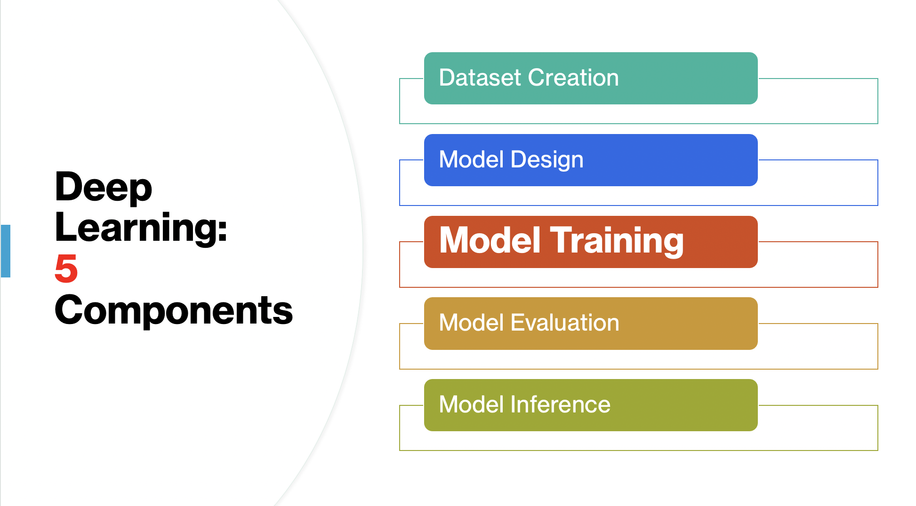
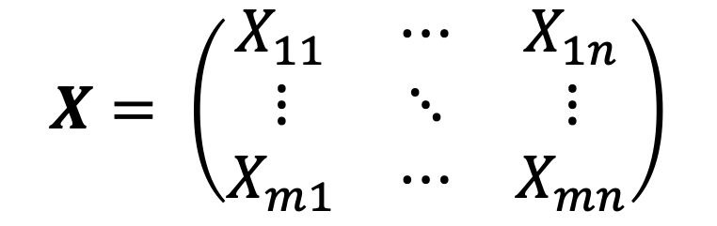
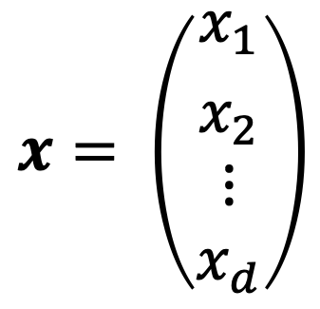
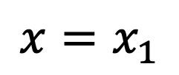
$$x= \left(\begin{aligned}{x_{1} \atop x_{2}} \\ ⋮ \\ x_{d}\end{aligned}\right)$$
$$X= \left(\begin{matrix}X_{11} & ⋯ & X_{1n} \\ ⋮ & ⋱ & ⋮ \\ X_{m1} & ⋯ & X_{mn}\end{matrix}\right)$$
$$x=x_{1}$$
Manipulation of numbers: scalars, vectors, matrices, and tensors

Slide 23
To get started, let’s revisit the following

Slide 24
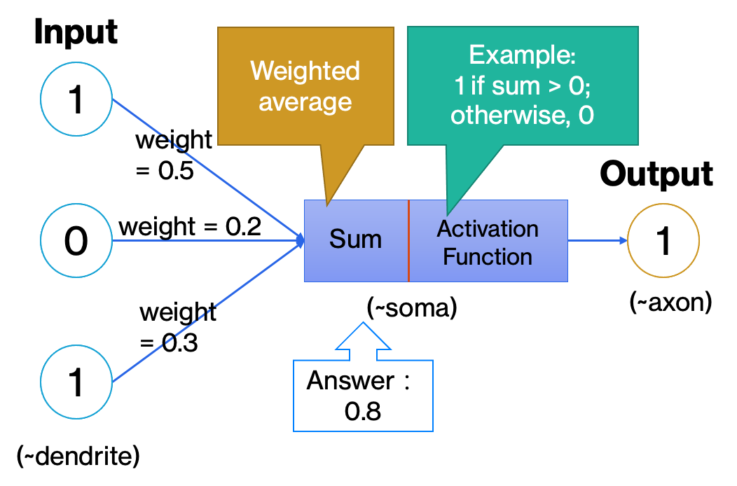
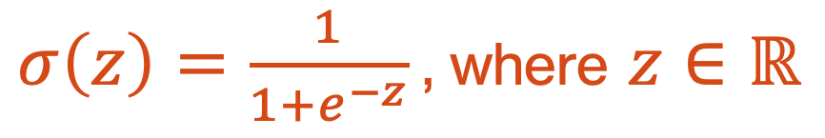
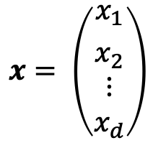

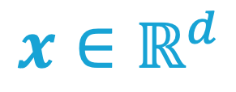
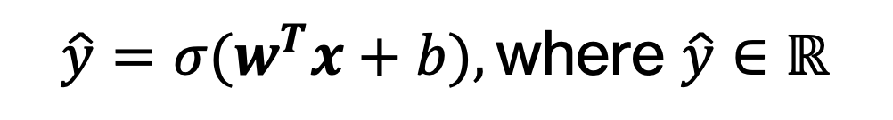

A Simple Neuron
Given the input
$$x= \left(\begin{aligned}{x_{1} \atop x_{2}} \\ ⋮ \\ x_{d}\end{aligned}\right)$$
$$x∈ℝ^{d}$$
We have
$$w∈ℝ^{d}$$
$$b∈ℝ$$
and
$σ\left(z\right)=\frac{1}{1+e^{−z}}$, where $z∈ℝ$
A sigmoid function as an example
The output is
$${\hat{y}=σ(w}^{T}x+b),\text{where} \hat{y}∈ℝ$$

Slide 25
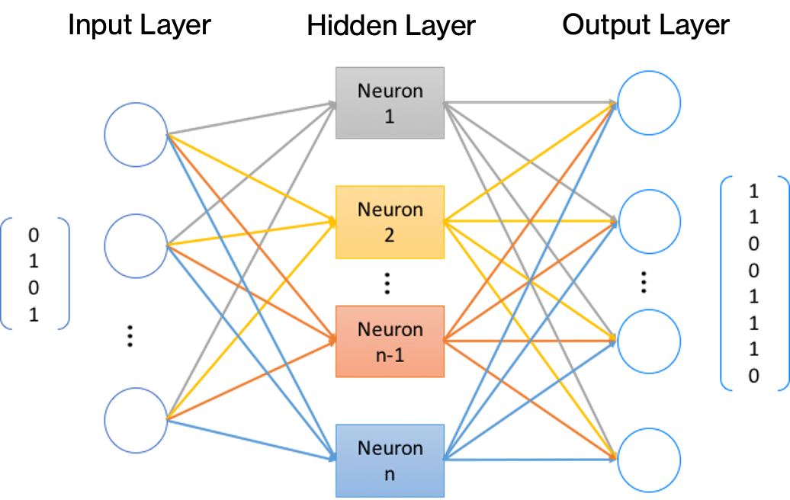

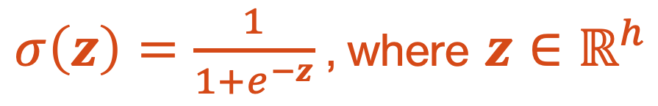

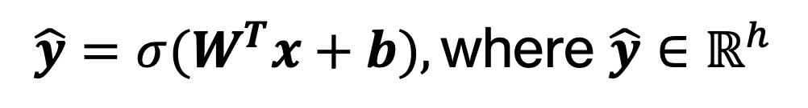
A Simple Network
Given the input
$$x∈ℝ^{d}$$
Element-wise operation here
We have
$$W∈ℝ^{d×h}$$
$$b∈ℝ^{h}$$
$σ\left(z\right)=\frac{1}{1+e^{−z}}$, where $z∈ℝ^{h}$
and
The output is
$${\hat{y}=σ(W}^{T}x+b),\text{where} \hat{y}∈ℝ^{h}$$

Slide 26
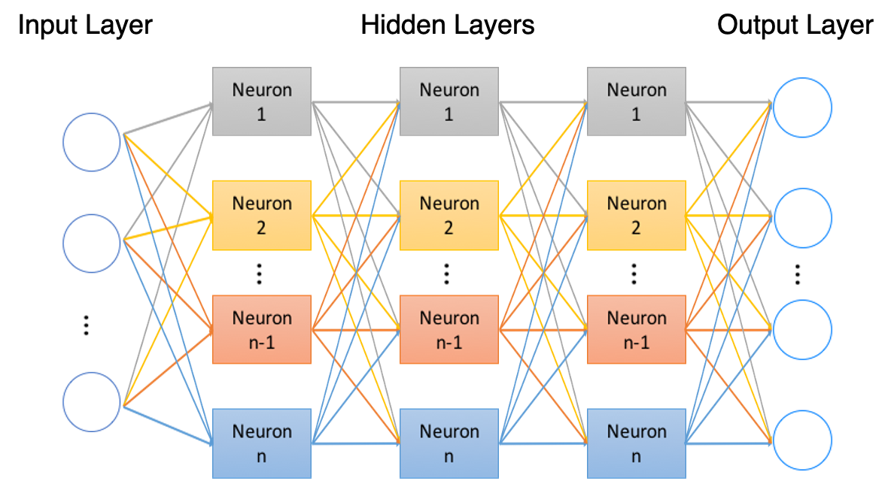



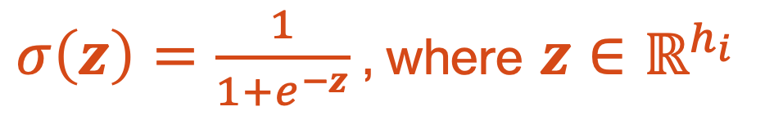

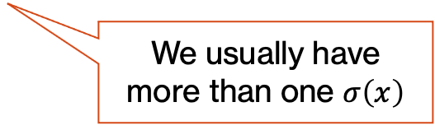
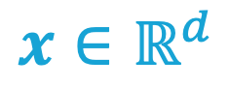


A Simple Deep Neural Network
Given the input
$$x∈ℝ^{d}$$
We have
$W_{1}∈ℝ^{d×h_{1}}$
$$b_{1}∈ℝ^{h_{1}}$$
$σ\left(z\right)=\frac{1}{1+e^{−z}}$, where $z∈ℝ^{h_{i}}$
$W_{2}∈ℝ^{h_{1}×h_{2}}$
$$b_{2}∈ℝ^{h_{2}}$$
and
…
…
$W_{n}∈ℝ^{h_{n−1}×h_{n}}$
$$b_{n}∈ℝ^{h_{n}}$$
We usually have more than one $σ\left(x\right)$
The output is
$\hat{y}={σ(W}_{n}^{T}\left(…σ\left(W_{2}^{T}\left(σ\left(W_{1}^{T}x+b_{1}\right)\right)+b_{2}\right)…\right)+b_{n})$, where $\hat{y}∈ℝ^{h_{n}}$

Slide 27
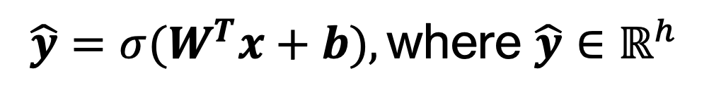
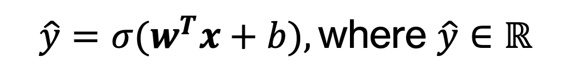
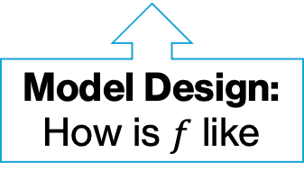
$${\hat{y}=σ(w}^{T}x+b),\text{where} \hat{y}∈ℝ$$
$${\hat{y}=σ(W}^{T}x+b),\text{where} \hat{y}∈ℝ^{h}$$
$\hat{y}={σ(W}_{n}^{T}\left(…σ\left(W_{2}^{T}\left(σ\left(W_{1}^{T}x+b_{1}\right)\right)+b_{2}\right)…\right)+b_{n})$, where $\hat{y}∈ℝ^{h_{n}}$
As we’d like to focus on model training rather than model design, we have
$\hat{y}=f_{θ}(x)$, where $θ=(W_{1},b_{1},W_{2},b_{2},…,W_{n},b_{n})$
Model Design: How is $f$ like
Model Training:
Find our parameters ☺

Slide 28
We’re ready to train our model!

Slide 29
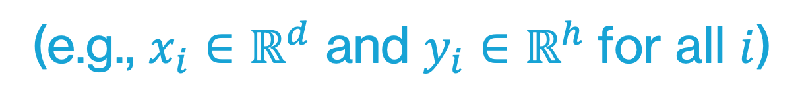
Data First!
After this
For example, we have
${\{\left(x_{i},y_{i}\right)\}}_{i=1}^{m}=\{\left(x_{1},y_{1}\right),\left(x_{2},y_{2}\right),…,\left(x_{m},y_{m}\right)\}$
(e.g., $x_{i}∈ℝ^{d}$ and $y_{i}∈ℝ^{h}$for all $i$)
We can also have other options like $x_{i}∈{[0,255]}^{d}$ and $y_{i}∈\{0, …, \left|class\right|\}$, depending on the nature of our task.

Slide 30
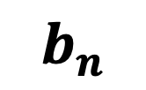
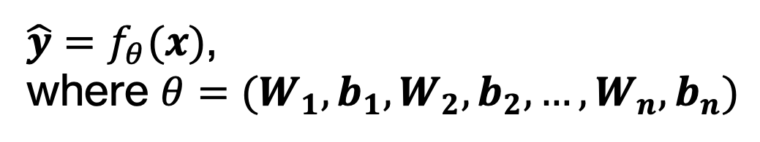
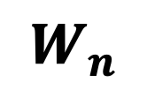

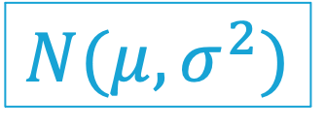
Initialize our parameters
We have
$\hat{y}=f_{θ}(x)$,
where $θ=(W_{1},b_{1},W_{2},b_{2},…,W_{n},b_{n})$
After this
A simple example:
$$W_{n}$$
$$N(μ,σ^{2})$$
$$b_{n}$$
$$0$$

Slide 31
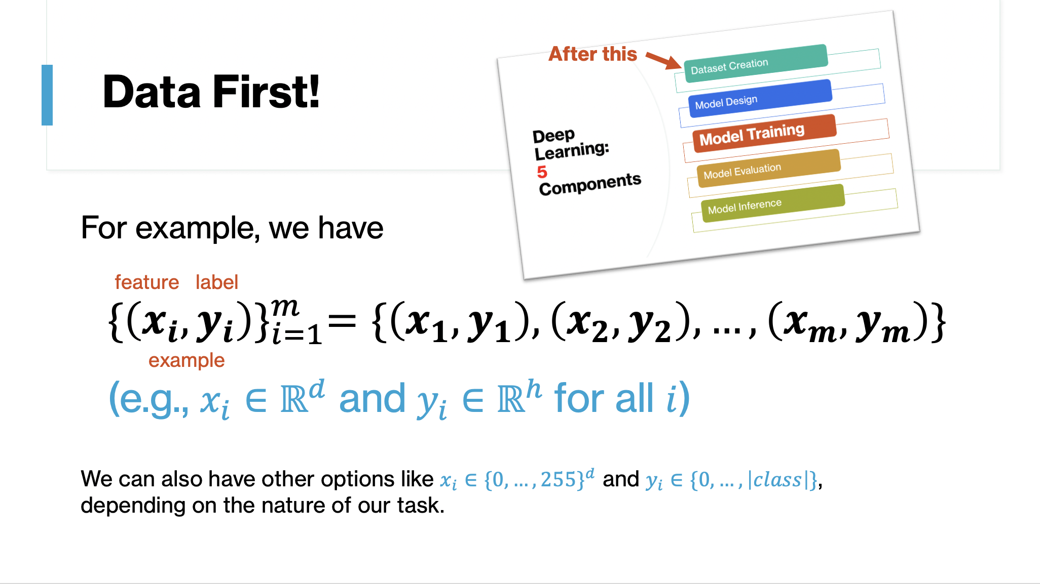
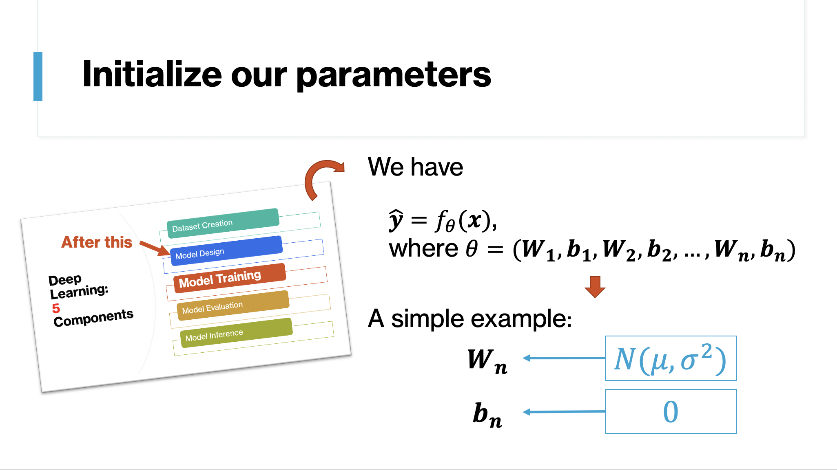
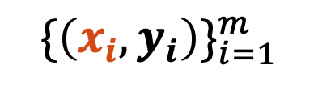
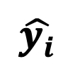
Forward propagation
$${\{\left(x_{i},y_{i}\right)\}}_{i=1}^{m}$$
$f_{θ}(x)$, where $θ=(W_{1},b_{1},W_{2},b_{2},…,W_{n},b_{n})$
$$\hat{y_{i}}$$
Initialized

Slide 32
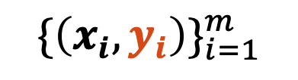
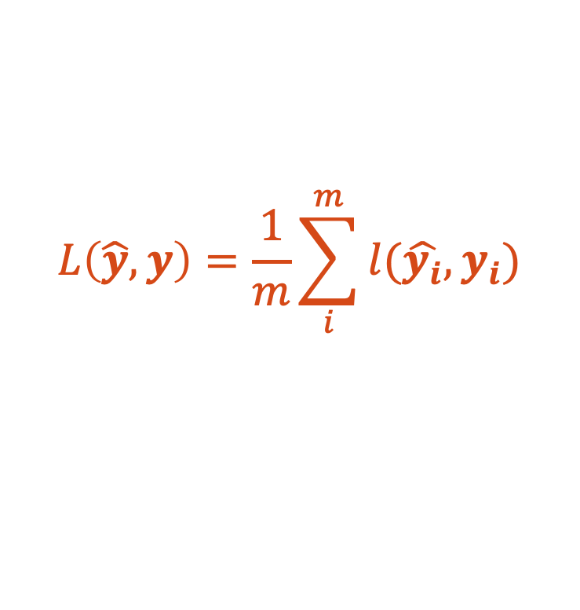

Loss computation
$${\{\left(x_{i},y_{i}\right)\}}_{i=1}^{m}$$
$f_{θ}(x)$, where $θ=(W_{1},b_{1},W_{2},b_{2},…,W_{n},b_{n})$
$$\hat{y_{i}}$$
$$L\left(\hat{y},y\right)=\frac{1}{m}\sum_{i}^{m}{l(\hat{y_{i}},y_{i})}$$
Mean Absolute Error (MAE),
Mean Squared Error (MSE),
Cross-entropy Loss and more

Slide 33

Parameter adjustment
Let’s use this
$$L\left(\hat{y},y\right)$$
How?
To “improve” our parameters
$$θ=(W_{1},b_{1},W_{2},b_{2},…,W_{n},b_{n})$$

Slide 34
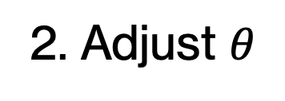
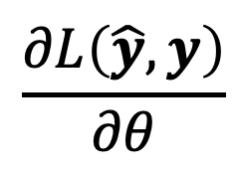
Consider this
Loss L
$$\frac{∂L\left(\hat{y},y\right)}{∂θ}$$
1. Find
Case 2:
w is too large
2. Adjust $θ$
Case 1:
w is too small
Slope > 0
Slope < 0
Slope = 0
Parameter w

Slide 35
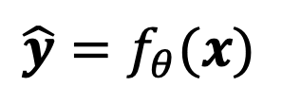
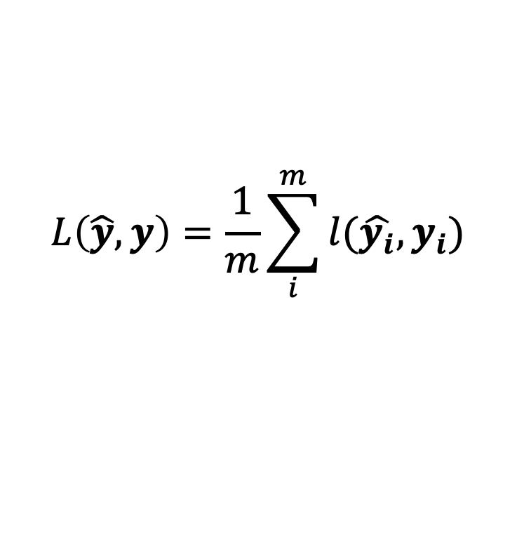
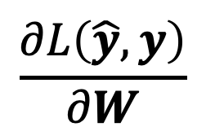
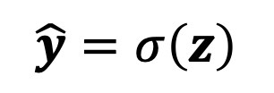
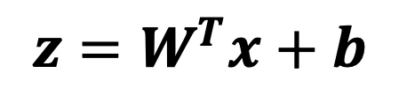
Back propagation
An Example
$${\hat{y}=f}_{θ}(x)$$
$$L\left(\hat{y},y\right)=\frac{1}{m}\sum_{i}^{m}{l(\hat{y_{i}},y_{i})}$$
$${z=W}^{T}x+b$$
$$\hat{y}=σ\left(z\right)$$
$$\frac{∂L\left(\hat{y},y\right)}{∂W}$$
How can we find
?
Chain rule!

Slide 36
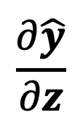
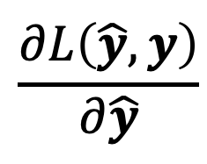
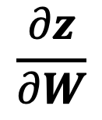
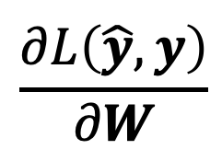
Back propagation
An Example
$${\hat{y}=f}_{θ}(x)$$
$$L\left(\hat{y},y\right)=\frac{1}{m}\sum_{i}^{m}{l(\hat{y_{i}},y_{i})}$$
$${z=W}^{T}x+b$$
$$\hat{y}=σ\left(z\right)$$
$$\frac{∂z}{∂W}$$
$$\frac{∂\hat{y}}{∂z}$$
$$\frac{∂L\left(\hat{y},y\right)}{∂\hat{y}}$$
$$\frac{∂L\left(\hat{y},y\right)}{∂W}$$

Slide 37
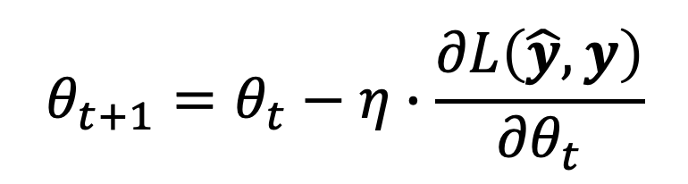
Optimization
A Simple Example: Stochastic/Mini-batch Gradient Descent
For all $θ=(W_{1},b_{1},W_{2},b_{2},…,W_{n},b_{n})$ at step t, we have
Learning rate
$$θ_{t+1}=θ_{t}−η∙\frac{∂L\left(\hat{y},y\right)}{{∂θ}_{t}}$$
From back propagation

Slide 38
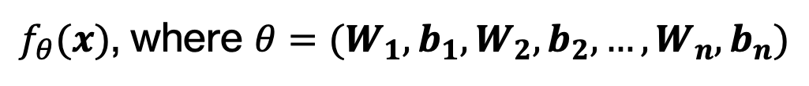
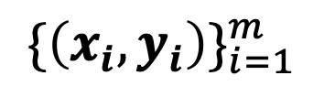
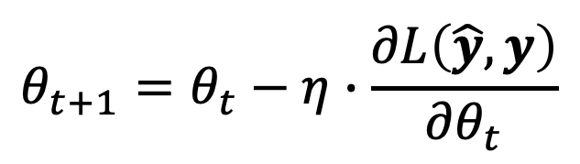


Iteration
$${\{\left(x_{i},y_{i}\right)\}}_{i=1}^{m}$$
$$\hat{y_{i}}$$
$$L\left(\hat{y},y\right)$$
$f_{θ}(x)$, where $θ=(W_{1},b_{1},W_{2},b_{2},…,W_{n},b_{n})$
$$θ_{t+1}=θ_{t}−η∙\frac{∂L\left(\hat{y},y\right)}{{∂θ}_{t}}$$

Slide 39
When should we stop training?
No. of steps
No. of epochs
Early stopping

Slide 40











Early Stopping
$${\{\left(x_{i},y_{i}\right)\}}_{i=1}^{m}$$
$$\hat{y_{i}}$$
$$L\left(\hat{y},y\right)$$
$f_{θ}(x)$, where $θ=(W_{1},b_{1},W_{2},b_{2},…,W_{n},b_{n})$
Training
Overfitting?
$$θ_{t+1}=θ_{t}−η∙\frac{∂L\left(\hat{y},y\right)}{{∂θ}_{t}}$$
$$L\left(\hat{y},y\right)$$
$$L\left(\hat{y_{V}},y_{V}\right)$$
$${\{\left({x_{V}}_{i},{y_{V}}_{i}\right)\}}_{i=1}^{m_{v}}$$
$f_{θ}(x_{V})$, where $θ=(W_{1},b_{1},W_{2},b_{2},…,W_{n},b_{n})$
$$\hat{y_{V_{i}}}$$
$$L\left(\hat{y_{V}},y_{V}\right)$$
Validation

Slide 41




Deep Learning Tasks
$${\{\left(x_{i},y_{i}\right)\}}_{i=1}^{m}$$
$$\hat{y_{i}}$$
$$L\left(\hat{y},y\right)$$
$f_{θ}(x)$, where $θ=(W_{1},b_{1},W_{2},b_{2},…,W_{n},b_{n})$
Training
$$θ_{t+1}=θ_{t}−η∙\frac{∂L\left(\hat{y},y\right)}{{∂θ}_{t}}$$
$${\{\left({x_{V}}_{i},{y_{V}}_{i}\right)\}}_{i=1}^{m_{v}}$$
$f_{θ}(x_{V})$, where $θ=(W_{1},b_{1},W_{2},b_{2},…,W_{n},b_{n})$
$$\hat{y_{V_{i}}}$$
$$L\left(\hat{y_{V}},y_{V}\right)$$
Validation

Slide 42
Other Interesting Issues
Programming for Data Training
Different Modes of Training: Supervised Training and Beyond
Optimization Algorithms
Design of Training Tasks
Advanced Training Methods (e.g., training using trained models)
Specific Examples of Training (e.g., translation, image processing, regression, time series forecasting, and more): To be explored in conjunction with dataset creation and model building

Slide 43
Thank you!

